Slide 2
INDIAN TECHNICAL AND ECONOMIC
COOPERATION (ITEC) PROGRAMME
ITEC Programme was instituted in 1964 as a bilateral programme of assistance of the Government of India.
The decision regarding setting up the ITEC programme was predicated on the underlying belief that "it was necessary to establish relations of mutual concern and inter-dependence based not only on commonly held ideals and aspirations, but also on solid economic foundations. Technical and economic cooperation was considered to be one of the essential functions of an integrated and imaginative foreign policy.“
The ITEC Programme is fully funded by the Government of India.

Slide 3
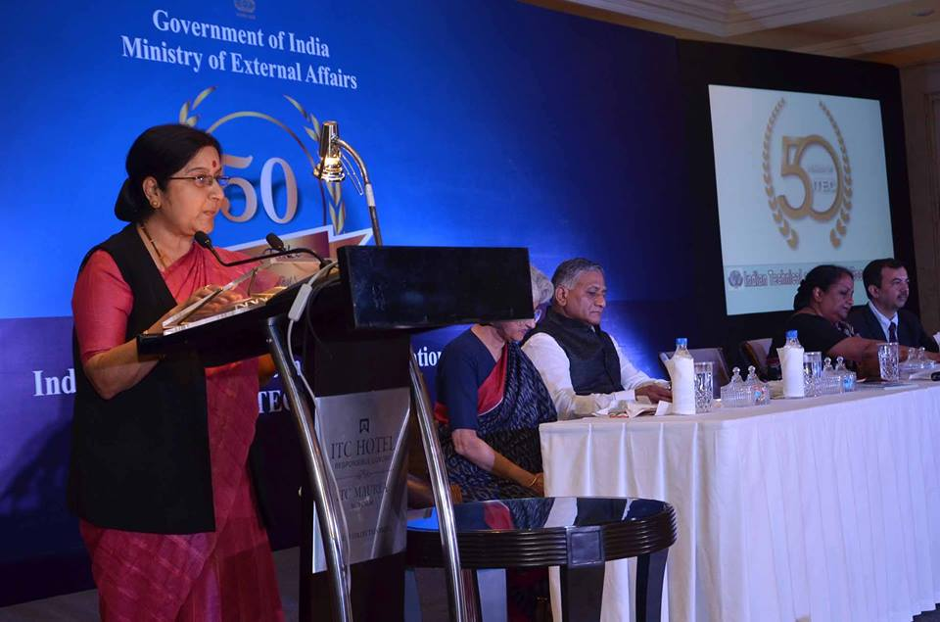
Hon’ble Minister of External Affairs, Government of India speaking at the Golden Jubilee Celebrations (50 Years) of ITEC in 2014
Under ITEC and its sister programme SCAAP (Special Commonwealth African Assistance Programme), 161 countries in Asia, Africa, East Europe, Latin America, the Caribbean as well as Pacific and Small Island countries are invited to share in the Indian developmental experience.

Slide 4
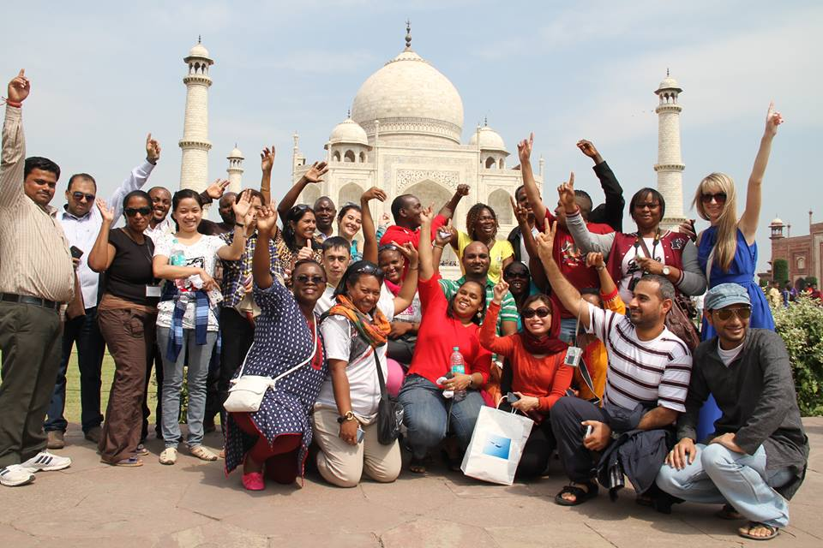
ITEC resources have also been used for cooperation programmes conceived in regional and inter-regional context such as Economic Commission for Africa, Industrial Development Unit of Commonwealth Secretariat, UNIDO, Group of 77 and G-15.
Its activities have also been associated with regional and multilateral organizations and cooperation groupings like Association of South East Asian Nations (ASEAN), Bay of Bengal Initiative for Multi-Sectoral Technical and Economic Cooperation (BIMSTEC), Mekong-Ganga Cooperation (MGC), African Union (AU), Afro-Asian Rural Development Organization (AARDO), Pan African Parliament, Caribbean Community (CARICOM), World Trade Organization (WTO) and Indian Ocean Rim - Association for Regional Cooperation (IOR-ARC) and India-Africa Forum Summit.

Slide 5
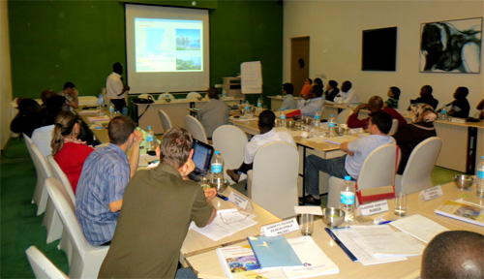
The ITEC/SCAAP Programme has the following components :
Training (civilian and defence) in India of nominees from ITEC partner countries;
Projects and project related activities such as feasibility studies and consultancy services;
Deputation of Indian experts abroad;
Study Tours;
Gifts/Donations of equipment at the request of ITEC partner countries; and
Aid for Disaster Relief .

Slide 6
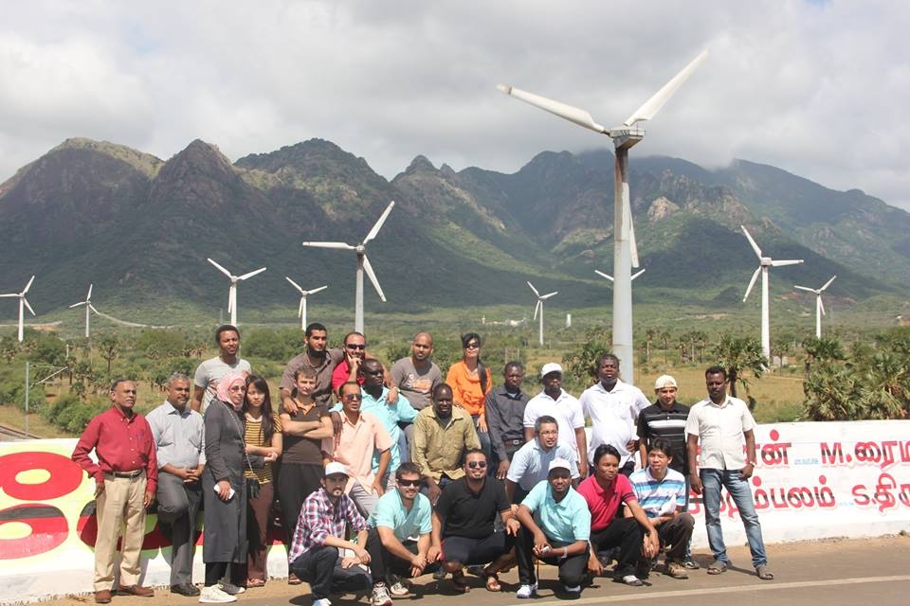
Training
Training or capacity building is one of the major activities under ITEC.
The professionals and people from developing countries are offered unique training courses, both civilian and defence, in different centres of excellence in India which empower them with not just professional skills, but prepare them for an increasingly globalized world.

Slide 7
Civilian Training Programme:
It is fully sponsored by the Government of India.
There are 47 empanelled institutions conducting 280 short-term, medium
term and long-term courses during the year.
The training programme is demand-driven and subjects selected areas of interest to developing countries for their working professionals on a wide and diverse range of skills and disciplines.
The courses have been divided into seven broad categories for easy identification :
Accounts, Audit, Banking and Finance Courses;
IT, Telecommunication and English Courses;
Management Courses;
SME/Rural Development Courses;
Specialized Courses;
Technical Courses; and
Environment and Renewable Energy Courses.

Slide 8
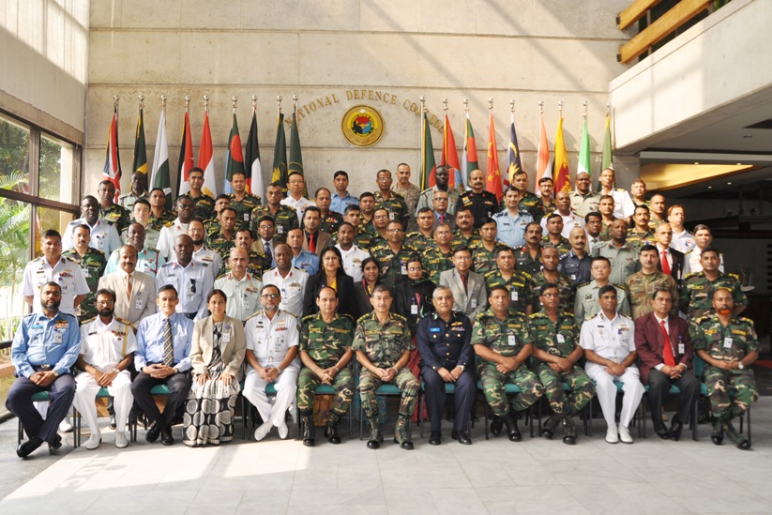
(b) Defence Training:
This covers training of personnel belonging to all the three wings of Defence Services, viz., Army, Air Force and Navy nominated by the ITEC partner countries in prestigious institutions like National Defence College, Defence Services Staff College, etc.
The facility is also extended and availed of by some select developed countries on self financing basis. The training field covers Security and Strategic Studies, Defence Management, Marine and Aeronautical Engineering, Logistics and Management, etc.

Slide 9
Project-related Cooperation
India assists ITEC partner countries, on the basis of mutually agreed projects
Through project assistance, India also demonstrates the skills, technologies and human resource capabilities, which it has acquired in the course of its own development.
A number of bilateral projects are undertaken, notably in the fields of archaeological conservation, Information Technology, (IT) and Small and Medium Enterprises (SMEs).
Feasibility studies and consultancy services, at the request of ITEC partner countries, are also carried out under the Programme.

Slide 10
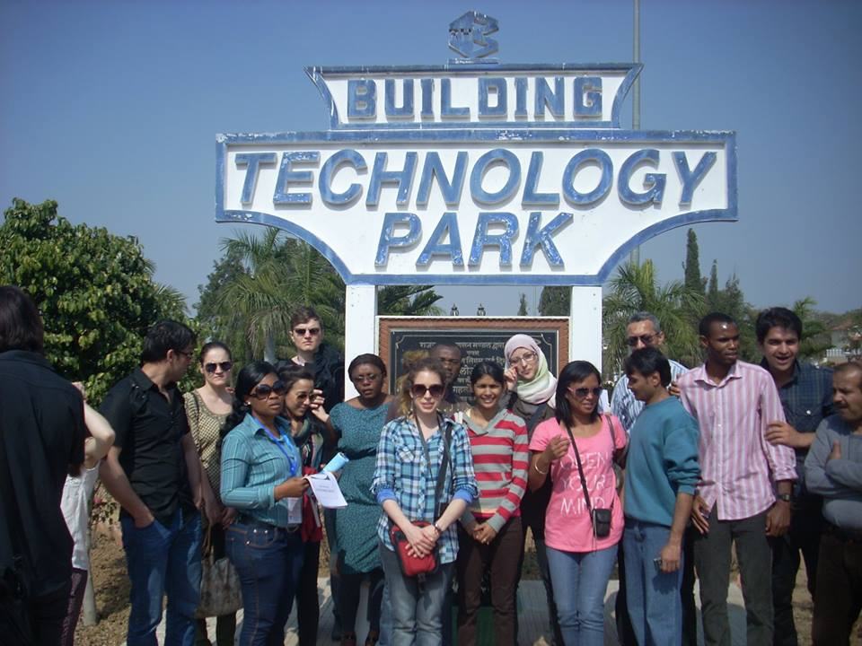
Deputation of Indian Experts
Indian experts are deputed to friendly countries on their request to assist in developmental activities.
Some of the fields covered in recent years have been creative arts, pest management, military training, IT, audit, medicine, English teaching, telecommunications, agricultural research, etc.
Study Tours
Study tours in India are undertaken at the specific request of ITEC partner countries. Specific areas of interest are identified and two to three weeks programme is arranged during which the delegates are taken to important institutions, training centres, and places of interest in different parts of India.

Slide 11
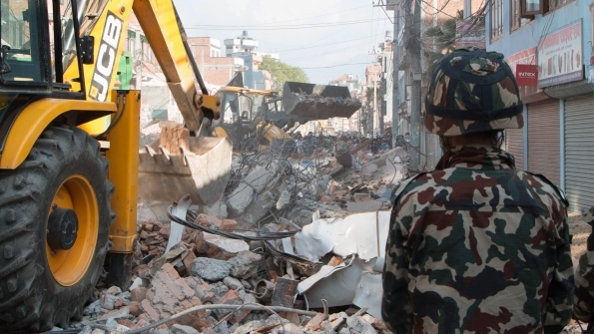
Gifts/Donations of Equipment
The Government of India provides gifts / donations of equipment to ITEC partner countries to assist in their developmental efforts. These gifts/ donations are usually in response to requests of these friendly countries and the commitments made by the political leadership.
Aid for Disaster Relief
Under this Programme, India supplies humanitarian aid like food grains, medicines and similar other items to countries struck by natural disasters. Cash assistance is also provided.

Slide 12
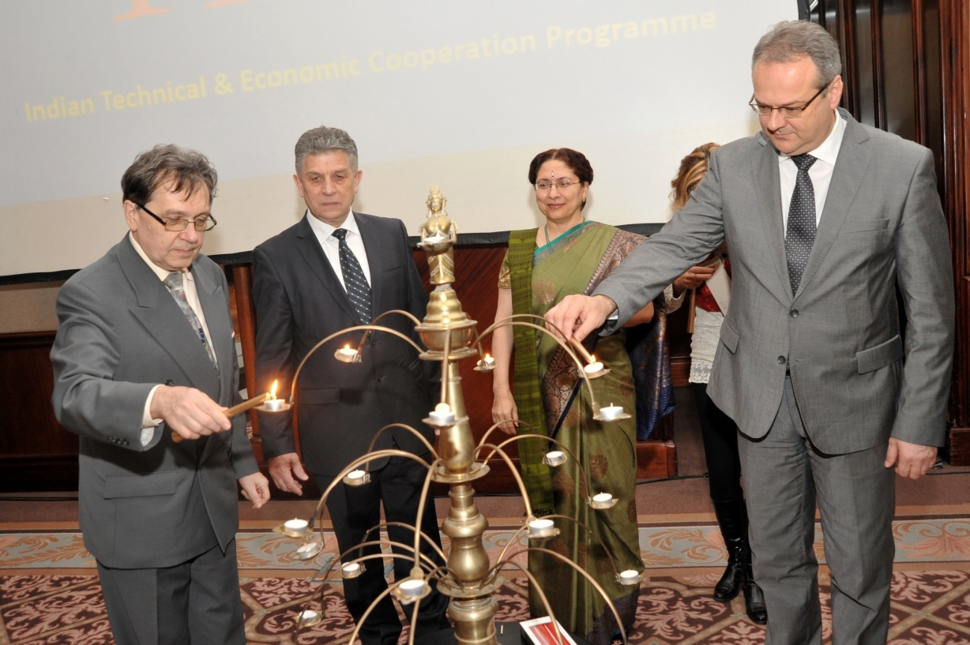
Cooperation with Republic of Serbia under ITEC Programme
The Indian Technical & Economic Cooperation (ITEC) Programme was extended to Serbia in 2008
Till date over 120 scholars from Serbia have been imparted training under the Programme

Slide 13
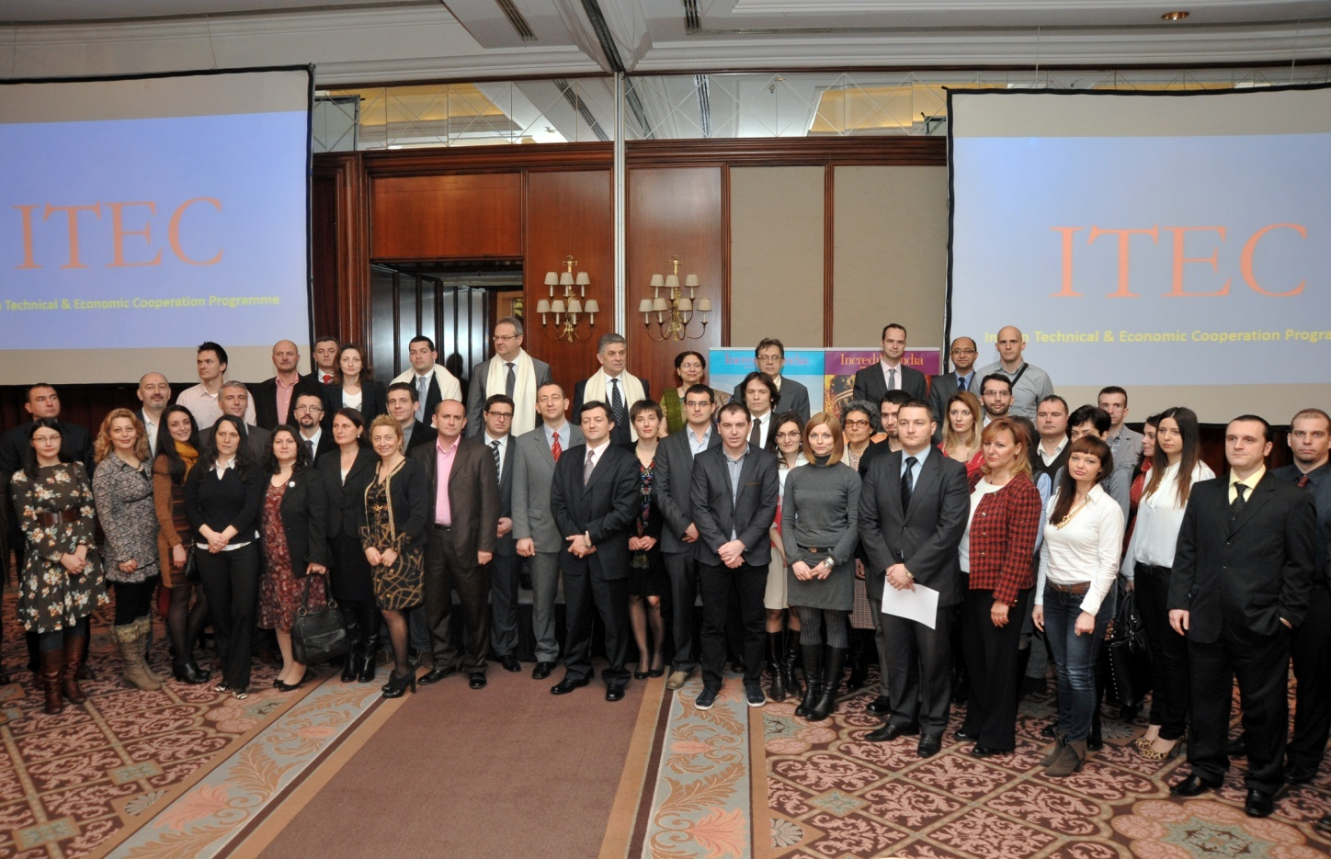
A total of 25 slots annually have been reserved for candidates from Serbia.
Under the Programme, Government of India bears the expenditure towards air fare, internal travel, accommodation, medical expenditure and the cost of the training/course fee including study tours/seminars which are part of the Training Programme.
Apart from this, the scholars are also paid living allowances and book allowances. Visa is issued to the applicants gratis.

Slide 14
Scholars who have undergone training under ITEC come from various fields of Serbian society, including both from Government and private sector.
The courses offered under ITEC are those which help the candidate develop the necessary skills for efficient discharge of their duties.
So far scholars from Serbia have been imparted training under the Programme in such diverse fields like proficiency in English & IT skill, Entrepreneurship Development, Development of ICT Skills, Public Expenditure Management, Business Research Methods & Data Analysis, Training Programme on Bio Energy, Climate Change & Sustainability, Textile Mill Management, Social Entrepreneurship, Banking & Finance, Special Courses on Leadership in Postal Sector, Decentralised Energy Solutions, Management courses for senior level executives, Wireless networking, MPLS Technologies, Mobile Communication Technologies, Operation Management, Public Service delivery leadership, Rural Development, Gender Issues in Labour, Asset Liability Management, Telemedicine, Cluster Development Executives, Next Generation Network Technologies & Future Trends, Geographic Information System, Consultancy Services for Small & Medium Enterprises, Web Application courses etc.

Slide 15
In Addition, training is also made available in special courses on WTO issues like Agriculture Services, Trade Related Aspects of Intellectual Property Rights (TRIPS) & Regional Trade Agreements (RTAs) etc.
ITEC programme is fast becoming one of the most active areas of bilateral cooperation between India and Serbia.
As Serbia follows a European path today and tackles its economic reforms in the midst of global and regional economic crisis, India’s experience of development and economic reforms is available to Serbia. This is where ITEC can play an important role.
Relevant and important training courses/programmes can be identified by mutual discussion so that there is not only quantitative increase but also qualitative increase in the effectiveness of training under ITEC
Detailed information is available at http://itec.mea.gov.in/

Slide 16
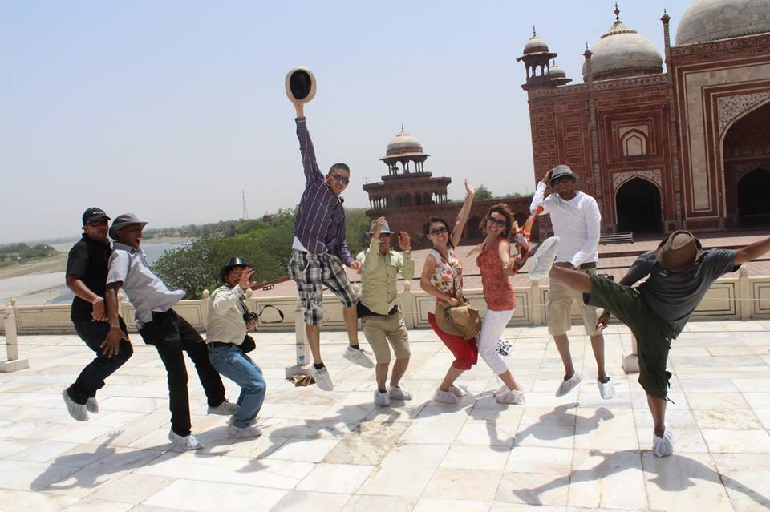
THANK YOU

